Slide 1
Computer Networks
Lecture 3: Introduction:
Delay, loss, throughput in networks
Protocol layers, service models Security
Prepared and modified by:
Assoc.Prof.Dr. Hossam Mahmoud Moftah
Associate Professor – Faculty of Computers and Artificial Intelligence– Beni-Suef University

Slide 2
Chapter 1: roadmap
  1.1 what is the Internet?
  1.2 network edge
    end systems, access networks, links
  1.3 network core
    packet switching, circuit switching, network structure
  1.4 delay, loss, throughput in networks
  1.5 protocol layers, service models
  1.6 networks under attack: security
  1.7 history
Adapted from J.F Kurose and K.W. Ross March 2012
Introduction
1-<number>

Slide 3

How do loss and delay occur?
packets queue in router buffers
packet arrival rate to link (temporarily) exceeds output link capacity
packets queue, wait for turn
packet being transmitted (delay)
A
B
packets queueing (delay)
free (available) buffers: arriving packets
dropped (loss) if no free buffers

Slide 4
Four sources of packet delay
transmission
A
propagation
B
nodal
processing
queueing
d_{nodal} = d_{proc} + d_{queue} + d_{trans} + d_{prop}
d_{proc}: nodal processing
check bit errors
determine output link
typically < msec
d_{queue}: queueing delay
time waiting at output link for transmission
depends on congestion level of router
Introduction
1-<number>

Slide 5
Four sources of packet delay
transmission
A
propagation
B
nodal
processing
queueing
d_{nodal} = d_{proc} + d_{queue} + d_{trans} + d_{prop}
d_{trans}: transmission delay:
L: packet length (bits)
R: link bandwidth (bps)
d_{trans} = L/R
d_{prop}: propagation delay:
d: length of physical link
s: propagation speed in medium (~2x10⁸ m/sec) (meter/second)
d_{prop} = d/s
d_{trans} and d_{prop}
very different
* Check out the Java applet for an interactive animation on trans vs. prop delay
1-<number>
Introduction

Slide 6
Four sources of packet delay
transmission
A
propagation
B
nodal
processing
queueing
d_{nodal} = d_{proc} + d_{queue} + d_{trans} + d_{prop}
The transmission delay is the amount of time required for the router to push out the packet.
The propagation delay, is the time it takes to propagate from one router to the next.

Slide 7
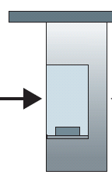

Caravan analogy
100 km
100 km
ten-car
caravan
toll
booth
toll
booth
cars “propagate” at
100 km/hr
toll booth takes 12 sec to service car (bit transmission time)
Car=bit; caravan =packet
Q: How long until caravan is lined up before 2nd toll booth?
time to “push” entire caravan through toll booth onto highway = 12*10 = 120 sec
time for last car to propagate from 1st to 2nd toll both: 100km/(100km/hr)= 1 hr
A: 62 minutes
Adapted from J.F Kurose and K.W. Ross March 2012
Introduction
1-<number>

Slide 8
Caravan analogy (more)
100 km
100 km
ten-car
caravan
toll
booth
toll
booth
suppose cars now “propagate” at 1000 km/hr
and suppose toll booth now takes one min to service a car
Q: Will cars arrive to 2nd booth before all cars serviced at first booth? Quiz
A: Yes! after 7 min, 1st car arrives at second booth; three cars still at 1st booth. (100/1000= 0.1 hr=6min+1=7 min)
Adapted from J.F Kurose and K.W. Ross March 2012
Introduction
1-<number>

Slide 9


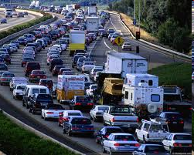
Queueing delay (revisited)
R: link bandwidth (bps)
L: packet length (bits)
a: average packet arrival rate (the average rate at which packets are arriving to be serviced) (e.g. packets/sec)
average queueing delay
traffic intensity
= La/R
La/R ~ 0: avg. queueing delay small
La/R -> 1: avg. queueing delay large
La/R > 1: more “work” arriving
than can be serviced, average delay infinite!
La/R ~ 0
La/R -> 1
Adapted from J.F Kurose and K.W. Ross March 2012
Introduction
1-<number>

Slide 10
Packet loss
queue (aka buffer) preceding link in buffer has finite capacity
packet arriving to full queue dropped (aka lost)
lost packet may be retransmitted by previous node, by source end system, or not at all
buffer
(waiting area)
A
packet being transmitted
B
packet arriving to
full buffer is lost
Adapted from J.F Kurose and K.W. Ross March 2012
Introduction
1-<number>

Slide 11
Throughput
throughput: rate (bits/time unit) at which bits transferred between sender/receiver
  instantaneous: rate at given point in time
  average: rate over longer period of time
  Usually, we mean average throughput
server, with
file of F bits
to send to client
link capacity
R_{s} bits/sec
link capacity
R_{c} bits/sec
server sends bits
(fluid) into pipe
pipe that can carry
fluid at rate
R_{s} bits/sec)
pipe that can carry
fluid at rate
R_{c} bits/sec)
Adapted from J.F Kurose and K.W. Ross March 2012
Introduction
1-<number>

Slide 12
Throughput (more)
R_{s} < R_{c} What is average end-end throughput?
R_{s} bits/sec
R_{c} bits/sec
R_{s} > R_{c} What is average end-end throughput?
R_{s} bits/sec
R_{c} bits/sec
Throughput = min{Rs,Rc}
bottleneck link
link on end-end path that constrains end-end throughput
Adapted from J.F Kurose and K.W. Ross March 2012
Introduction
1-<number>

Slide 13
Throughput: Internet scenario
per-connection end-end throughput:
in practice: bottleneck link is
R_{s}
min(R_{c},R_{s},R/6)
R_{s}
R_{s}
R
R_{c} or R_{s}
R_{c}
R_{c}
R_{c}
6 connections (fairly) share backbone bottleneck link R bits/sec
Adapted from J.F Kurose and K.W. Ross March 2012
Introduction
1-<number>

Slide 14
Measurements of network performance:
Bandwidth – capacity of the system
Throughput – number of bits that can be pushed through time
Delay (latency) – delay incurred by a bit from start to finish
Loss – number of bits lost (dropped) in the network
What is the difference between Throughput and bandwidth?
  Bandwidth is the maximum amount of data that can travel through a 'channel'.
  Throughput is how much data actually does travel through the 'channel' successfully. This can be limited by a ton of different things including latency, and what protocol you are using.
Adapted from J.F Kurose and K.W. Ross March 2012
Introduction
1-<number>

Slide 15
Chapter 1: roadmap
  1.1 what is the Internet?
  1.2 network edge
    end systems, access networks, links
  1.3 network core
    packet switching, circuit switching, network structure
  1.4 delay, loss, throughput in networks
  1.5 protocol layers, service models
  1.6 networks under attack: security
  1.7 history
Adapted from J.F Kurose and K.W. Ross March 2012
Introduction
1-<number>

Slide 16
Protocol “layers”
Networks are complex,
with many “pieces”:
  hosts
  routers
  links of various media
  applications
  protocols
  hardware, software
Question:
is there any hope of organizing structure of network?
Adapted from J.F Kurose and K.W. Ross March 2012
Introduction
1-<number>

Slide 17
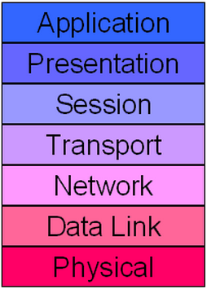
ISO/OSI reference model
application: supporting network applications
  FTP, SMTP, HTTP
transport: process-process data transfer
  TCP, UDP
network: routing of datagrams from source to destination
  IP, routing protocols
link: data transfer between neighboring network elements (use MAC address)
  Ethernet, 802.111 (WiFi), PPP
physical: bits “on the wire”
Adapted from J.F Kurose and K.W. Ross March 2012
Introduction
1-<number>
Notes:
Many application-level protocols. For each family of network, choices of transport-level and network-level protocols are quite limited. But, for different families, there can be completely different protocols at these two layers. At the lower layers, there is one or a few protocols for each different technology family.

Slide 18
ISO/OSI reference model
presentation: allow applications to interpret meaning of data, e.g., encryption, compression, machine-specific conventions
session: synchronization, checkpointing, recovery of data exchange
Adapted from J.F Kurose and K.W. Ross March 2012
Introduction
1-<number>

Slide 19
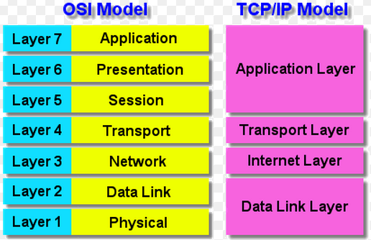
TCP/IP reference model
Adapted from J.F Kurose and K.W. Ross March 2012
Introduction
1-<number>

Slide 20
Encapsulation
source
message
M
application
transport
network
link
physical
segment
H_{t}
M
H_{t}
datagram
H_{n}
H_{n}
H_{t}
M
frame
H_{l}
H_{n}
H_{t}
M
link
physical
switch
destination
H_{n}
H_{t}
M
network
link
physical
M
application
transport
network
link
physical
H_{l}
H_{n}
H_{t}
M
H_{n}
H_{t}
M
H_{t}
M
H_{n}
H_{t}
M
H_{l}
H_{n}
H_{t}
M
router
Adapted from J.F Kurose and K.W. Ross March 2012
Introduction
1-<number>

Slide 21
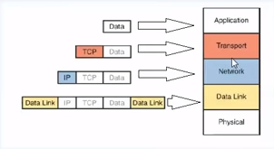
Encapsulation
segment
Packet or datagram
frame

Slide 22
Chapter 1: roadmap
  1.1 what is the Internet?
  1.2 network edge
    end systems, access networks, links
  1.3 network core
    packet switching, circuit switching, network structure
  1.4 delay, loss, throughput in networks
  1.5 protocol layers, service models
  1.6 networks under attack: security
  1.7 history
Adapted from J.F Kurose and K.W. Ross March 2012
Introduction
1-<number>

Slide 23
Network security
field of network security:
  how bad guys can attack computer networks
  how we can defend networks against attacks
  how to design architectures that are immune to attacks
Internet not originally designed with (much) security in mind
  original vision: “a group of mutually trusting users attached to a transparent network” ☺
  security considerations in all layers!
Adapted from J.F Kurose and K.W. Ross March 2012
Introduction
1-<number>

Slide 24
Bad guys: put malware into hosts via Internet
malware can get in host from:
  virus: self-replicating infection by receiving/executing object (e.g., e-mail attachment)
  worm: self-replicating infection by passively receiving object that gets itself executed (It does not need human action)
spyware malware can record keystrokes, web sites visited, upload info to collection site
Adapted from J.F Kurose and K.W. Ross March 2012
Introduction
1-<number>

Slide 25

Bad guys: attack server, network infrastructure
Denial of Service (DoS): attackers make resources (server, bandwidth) unavailable to legitimate traffic by cracking resource with false traffic
1. select target
2. break into hosts around the network
3. send packets to target from compromised hosts
A botnet is a collection of Internet-connected programs. it could be used to send spam email or participate in distributed denial-of-service attacks.
target
Adapted from J.F Kurose and K.W. Ross March 2012
Introduction
1-<number>

Slide 26
Bad guys can sniff packets
packet “sniffing”:
  broadcast media (shared ethernet, wireless)
  promiscuous network interface reads/records all packets (e.g., including passwords!) passing by
A
C
src:B dest:A payload
B
  wireshark software is a (free) packet-sniffer
Adapted from J.F Kurose and K.W. Ross March 2012
Introduction
1-<number>

Slide 27
Bad guys can use fake addresses
IP spoofing: send packet with false source address
A
C
src:B dest:A payload
B
… lots more on security (throughout, Chapter 8)
Adapted from J.F Kurose and K.W. Ross March 2012
Introduction
1-<number>

Slide 28
Network scanner using Python
A network scanner is an IP scanner that is used for scanning the networks that are connected to several computers.
There are two basic methods:
  ICMP Echo Request
  TCP Scan
Adapted from https://www.geeksforgeeks.org/network-scanner-in-python/

Slide 29
ICMP Echo Request
The Internet Control Message Protocol (ICMP) is a supporting protocol used by network devices, including routers, to send error messages and operational information indicating success or failure when communicating with another IP address, (wikipedia)
An ICMP packet is sent to a host using the IP address and if the ICMP echo is received, that means that the host is online and is receiving the signals.
Adapted from https://www.geeksforgeeks.org/network-scanner-in-python/

Slide 30
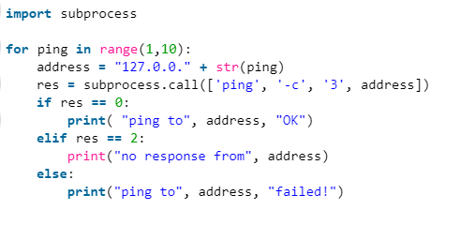
ICMP Echo Request
Adapted from https://www.geeksforgeeks.org/network-scanner-in-python/

Slide 31
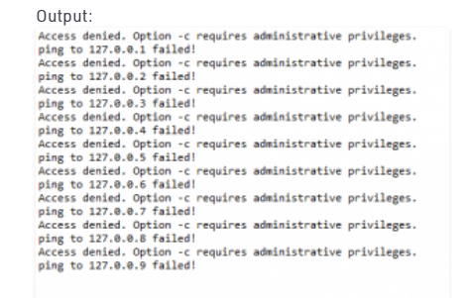
ICMP Echo Request
Adapted from https://www.geeksforgeeks.org/network-scanner-in-python/

Slide 32

TCP Scan
TCP scan method is introduced which works on three-way handshake method.
This method has a pre-assumption that the hosts on the networks are open ports and we have to guess which port is open or not.
The ports differ in the operating system in which you are using. Different OS has open dependent ports listed below.
Adapted from https://www.geeksforgeeks.org/network-scanner-in-python/

Slide 33
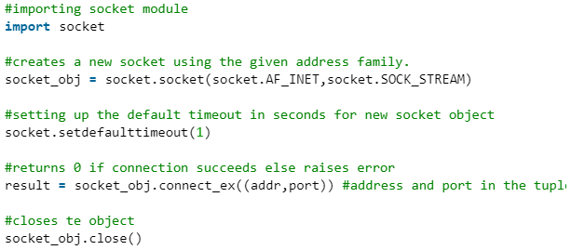
TCP Scan
It is a three-step method that requires both the client and server to exchange SYN and ACK (acknowledgment) packets before actual data communication begins
Adapted from https://www.geeksforgeeks.org/network-scanner-in-python/

Slide 34
The End
1-<number>

